Slide 1
Classification of arrhythmia using ecg data
Group 15
Sachi Tripathi (181500598)
Sarvesh Kumar Sharma (181500625)
Satyam Kumar Jha (181500627)
Shivani Chauhan (181500678)
Mentor-
Dr. Ashish Sharma

Slide 2
Objective
To distinguish between the presence and absence of cardiac arrhythmia and classify it in one of the 16 groups.

Slide 3
Overview
What is Arrhythmia?
Cardiac Arrhythmia is a form of irregularity in heart rhythms and, in some cases, results in heart diseases.
It is a type of disease that disturbs the smooth rhythm of heart’s electrical system.
It causes the heart to beat either too slow or too fast, to race, and to skip beats.
It causes nonsequential movement of heart signals.

Slide 4
How it is identified?
Generally, arrhythmia is identified and analyzed from an ECG(Electrocardiogram) recording.
Divided into two broad categories, that is, Bradycardia and Tachycardia.
Bradycardia causes the heart to beat too slow i.e. less than 60 beats per minute(bpm).
Tachycardia makes the heart beat faster which could go up to 100 bpm.

Slide 5
Contribution
The project proposes a diagnostic system built using Machine Learning.
The data is reduced using Principal Component Analysis (PCA).
Kernelized Support Vector Machine (SVM) is used for training our model.

Slide 6
Dataset
We have taken the dataset from UCI machine learning repository.
https://archive.ics.uci.edu/ml/datasets/Arrhythmia
Consists of 452 different training examples.
The 279 columns include the age, the sex, the height and the weight of the person as well as some ’workable’ information.

Slide 7
Proposed Work
DATA PRE-PROCESSING
Handling missing values
EXPLORATORY DATA ANALYSIS
Handling outliers
Data Visualization
DATA MODELLING
Modelling using KNN, Logistic Regression, Decision Tree Classifier, SVM, Random Forest Classifier

Slide 8
Data Preprocessing
The first step is data cleaning.
We observed that out of 279 attributes, 5 of them contained missing values.
Upon digging the data further, we found that an attribute contained almost 350 missing values.
We dropped that column and imputed the other columns containing missing data using their mean values.
Replaced the column names with appropriates names to make the data more understandable.
Finally, we separated the target attribute from the features of our data.

Slide 9
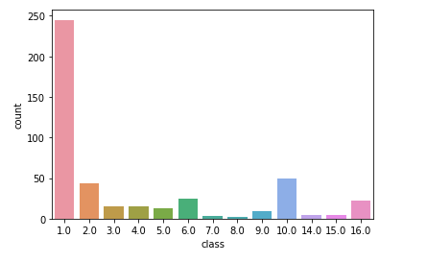
EXPLORATORY DATA ANALYSIS
Out of 452 samples, 245 were of class 1 which is for ‘normal people’.
Also, Atrio-Ventricular block Arrhythmia is not available in the dataset.
The samples of classes 7 and 8 are also very few, making our dataset highly imbalance.
The count of each class in our dataset is plotted using countplot.

Slide 10
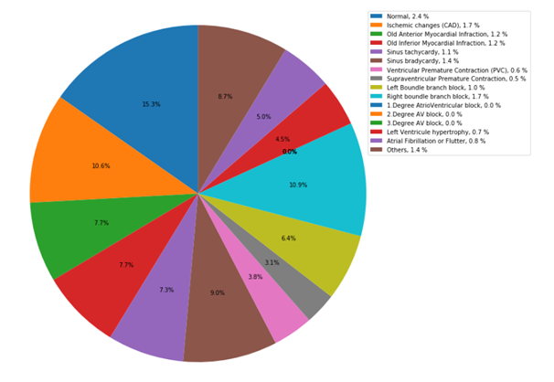
EXPLARATORY DATA ANALYSIS.....
To find the outliers, we visualized the pairwise distribution of a few features and handled those outliers using boxplots.
We then perform feature scaling and split our dataset using 80% as training dataset and 20% as testing data.
Percentage distribution of the counts using a pie chart

Slide 11
Data Modelling
The data is modelled using various algorithms:
K-nearest neighbours (KNN)
LOGISTIC REGRESSION
Decision tree
Random Forest
SUPPORT VECTOR MACHINE(SVM)

Slide 12
IMPLEMENTATION & RESULT ANALYSIS
Before performing Principal Component Analysis
After performing Principal Component Analysis
When trained over original data, Kernelized SVM proved to be the best among other classifiers in terms of recall value, with an accuracy percent of 79.12%.
Also, Logistic Regression showed better training accuracy.
No improvement in KNN results.
Random Forest too did not yield better results.
However, we obtained improvised results from Kernelized SVM model with an accuracy of 80.21%.

Slide 13
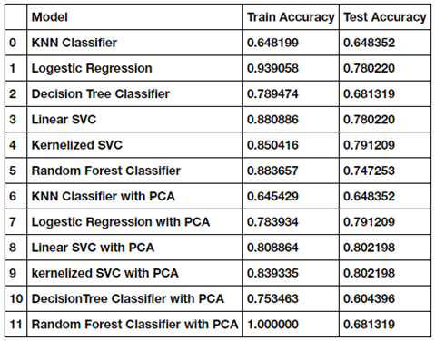
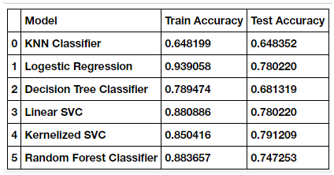
IMPLEMENTATION & RESULT ANALYSIS
Before performing Principal Component Analysis
After performing Principal Component Analysis

Slide 14
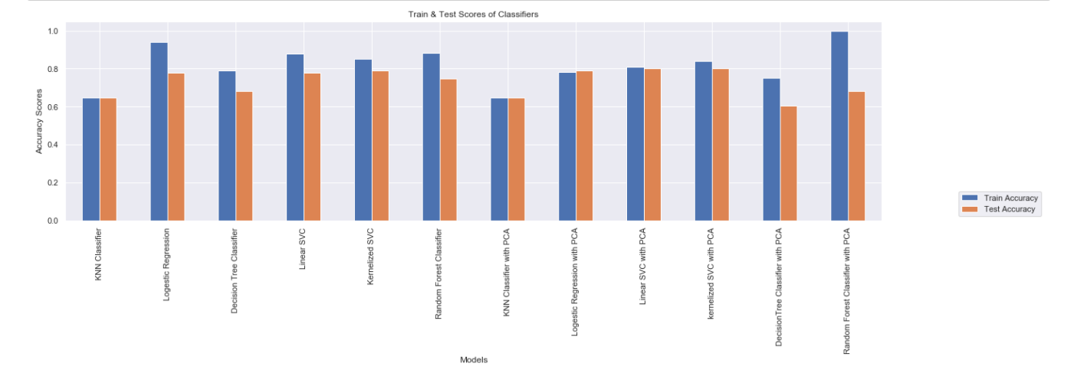
Visualization of final results

Slide 15
Conclusion
This study proposes a method for classification of arrhythmia using ECG data by implementing various machine learning techniques.
After cleaning and pre-processing, the data is modelled using multiple machine learning algorithms.
To improve the accuracy of the model, Principal Component Analysis (PCA) is performed over the data to reduce its dimensions.
The results show that Kernelized SVM outperformed other classifiers.
The model predicts the absence or presence of cardiac arrhythmia and classifies it into one of the 16 classes with an accuracy of 80.21%.
Our results suggest that Kernelized SVM model can be used to diagnose cardio-vascular diseases like arrhythmia in hospitals.

Slide 16
Thank You….

